Slide 1
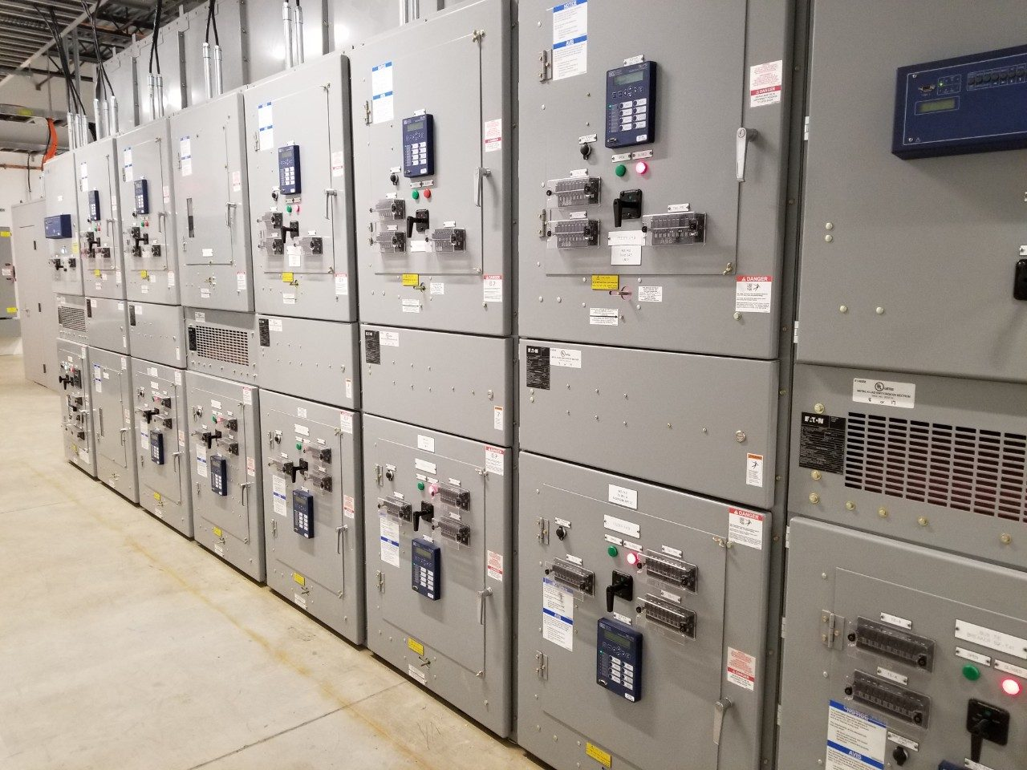

Team 54: Remote Thermal Viewing within High Voltage
Final Presentation Blake Bagley, Julia Garcia, Erica Mathew Sponsor: Powell Industries TA: Vishwam Raval
Notes:
Michelle

Slide 2
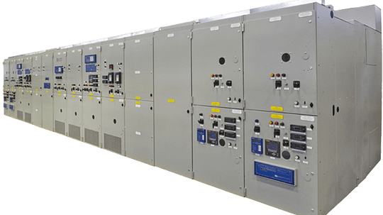

Project description
Problem statement: “As industry demand grows, space inside high voltage switchgear has become increasingly limited. Manufacturers are required to fit more devices and wires within the same limited space. Additionally, manufacturers are now being asked to include a remote viewing system within the switchgear to monitor a physical ground switch. This ground switch is physically blocked, by wires, from the view of the operator. A remote viewing system allows the operators job to be much safer and more convenient.”
Notes:
Erica: Our project sponsor is powell industries which is a “Powell Industries designs and manufactures equipment like switchgear, circuit breakers, and power management systems that help safely control and distribute electrical power in multiple different industries
Switchgears are Switchgears are devices that control and protect electrical circuits by turning power on or off and preventing damage during electrical faults.
Powell industries designs/maufactures
explain switchgears
explain project

Slide 3

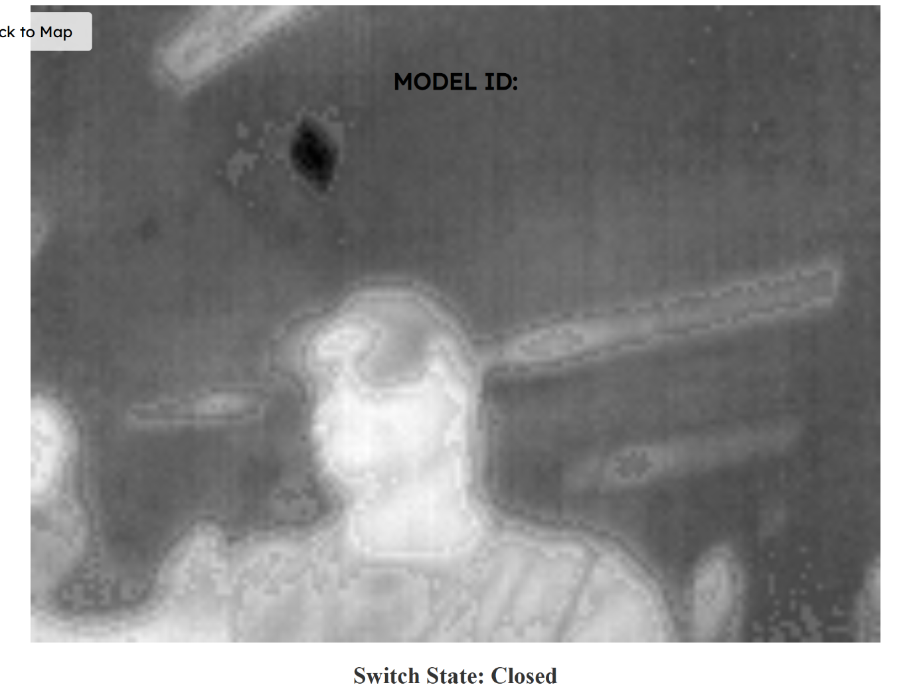
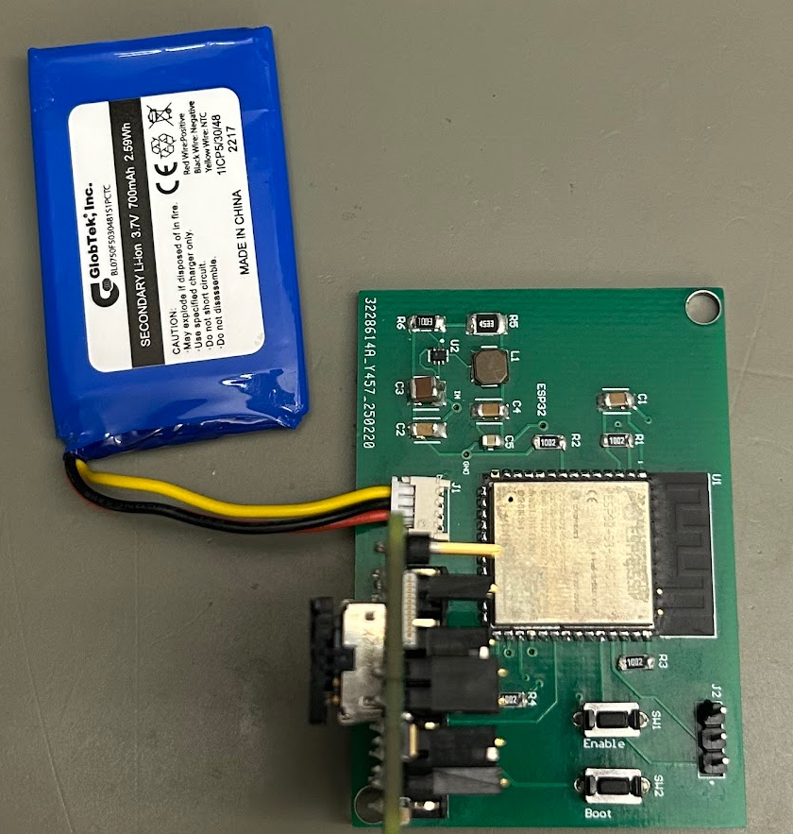
Integrated System Diagram
Power
MCU ⇔ Thermal Sensor
Microcontroller sends images to Website through HTTP Post
Thermal Sensor takes images
Website displays images one by one
Notes:
Julia: Design the power supply and overall hardware of the system.
Blake: Microcontroller coding and ML
Erica: Creating Web Application for users to interact with

Slide 4
PCB Design Accomplishments
This subsystem was designed to:
Provide power to and house the thermal sensor
Provide power to and house the microcontroller
Provide a connection between the two major components
Challenges and Solutions:
The microcontroller couldn’t download code.
This was handled by adding push-buttons to the original design.
The thermal sensor socket chosen was unable to be hand soldered without losing functionality
This was handled by replacing the socket and three of the buck converters with a breakout board that had a socket ready for use.
The breakout board is attached via connector that is soldered onto the main board.
The change caused the board’s width to decrease, but the height increased dramatically.
If the board was mass produced then the second version of the board would be viable and would be much more cost effective than the final version.

Slide 5
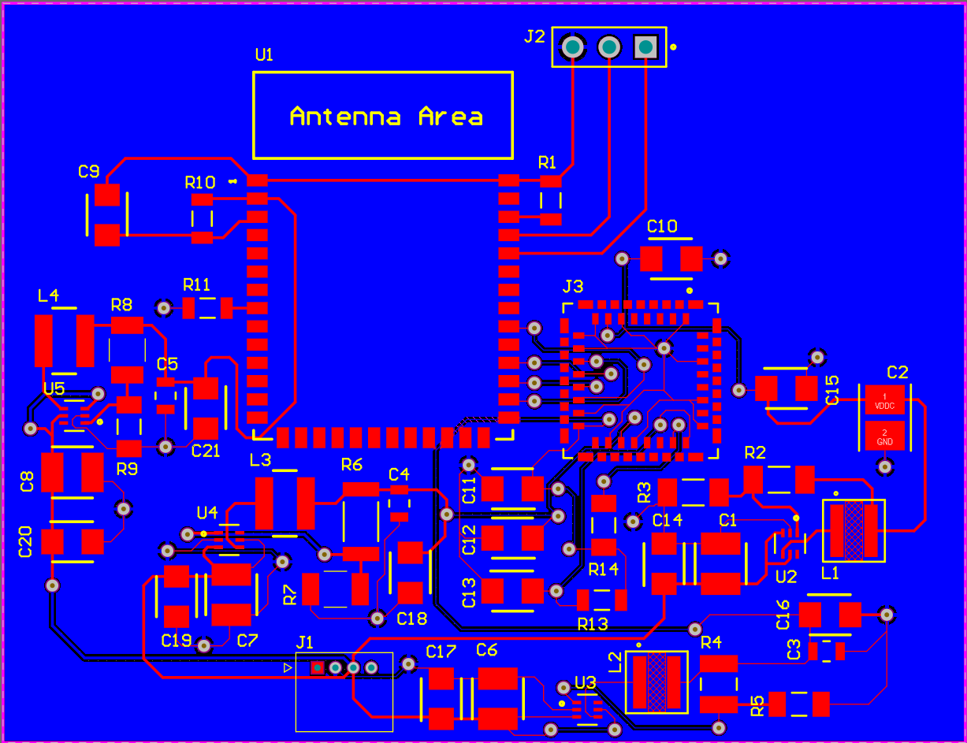
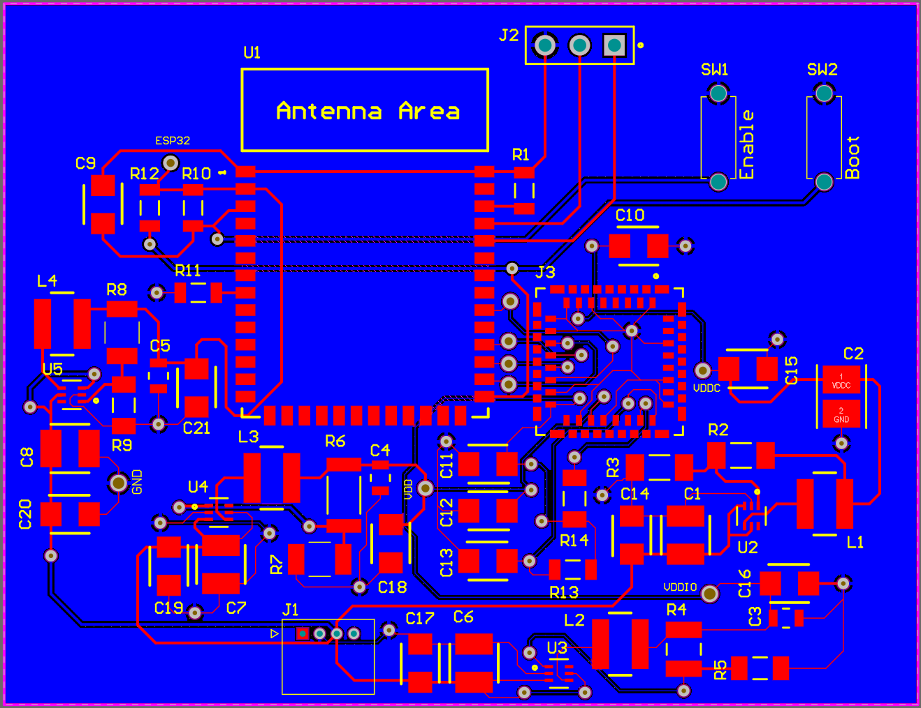
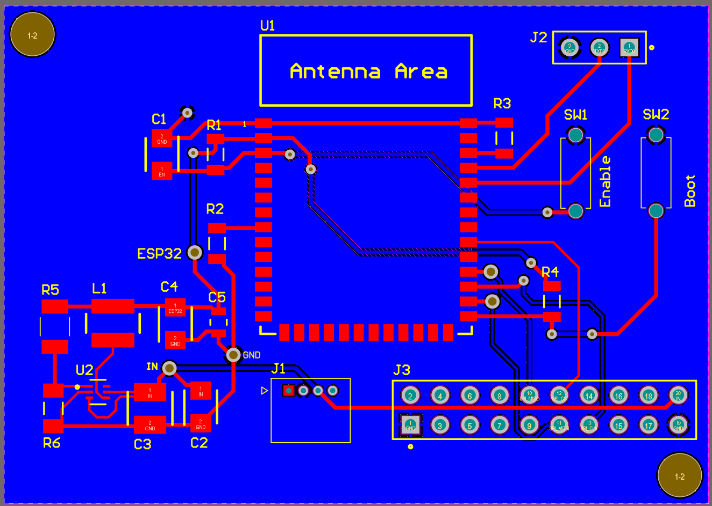
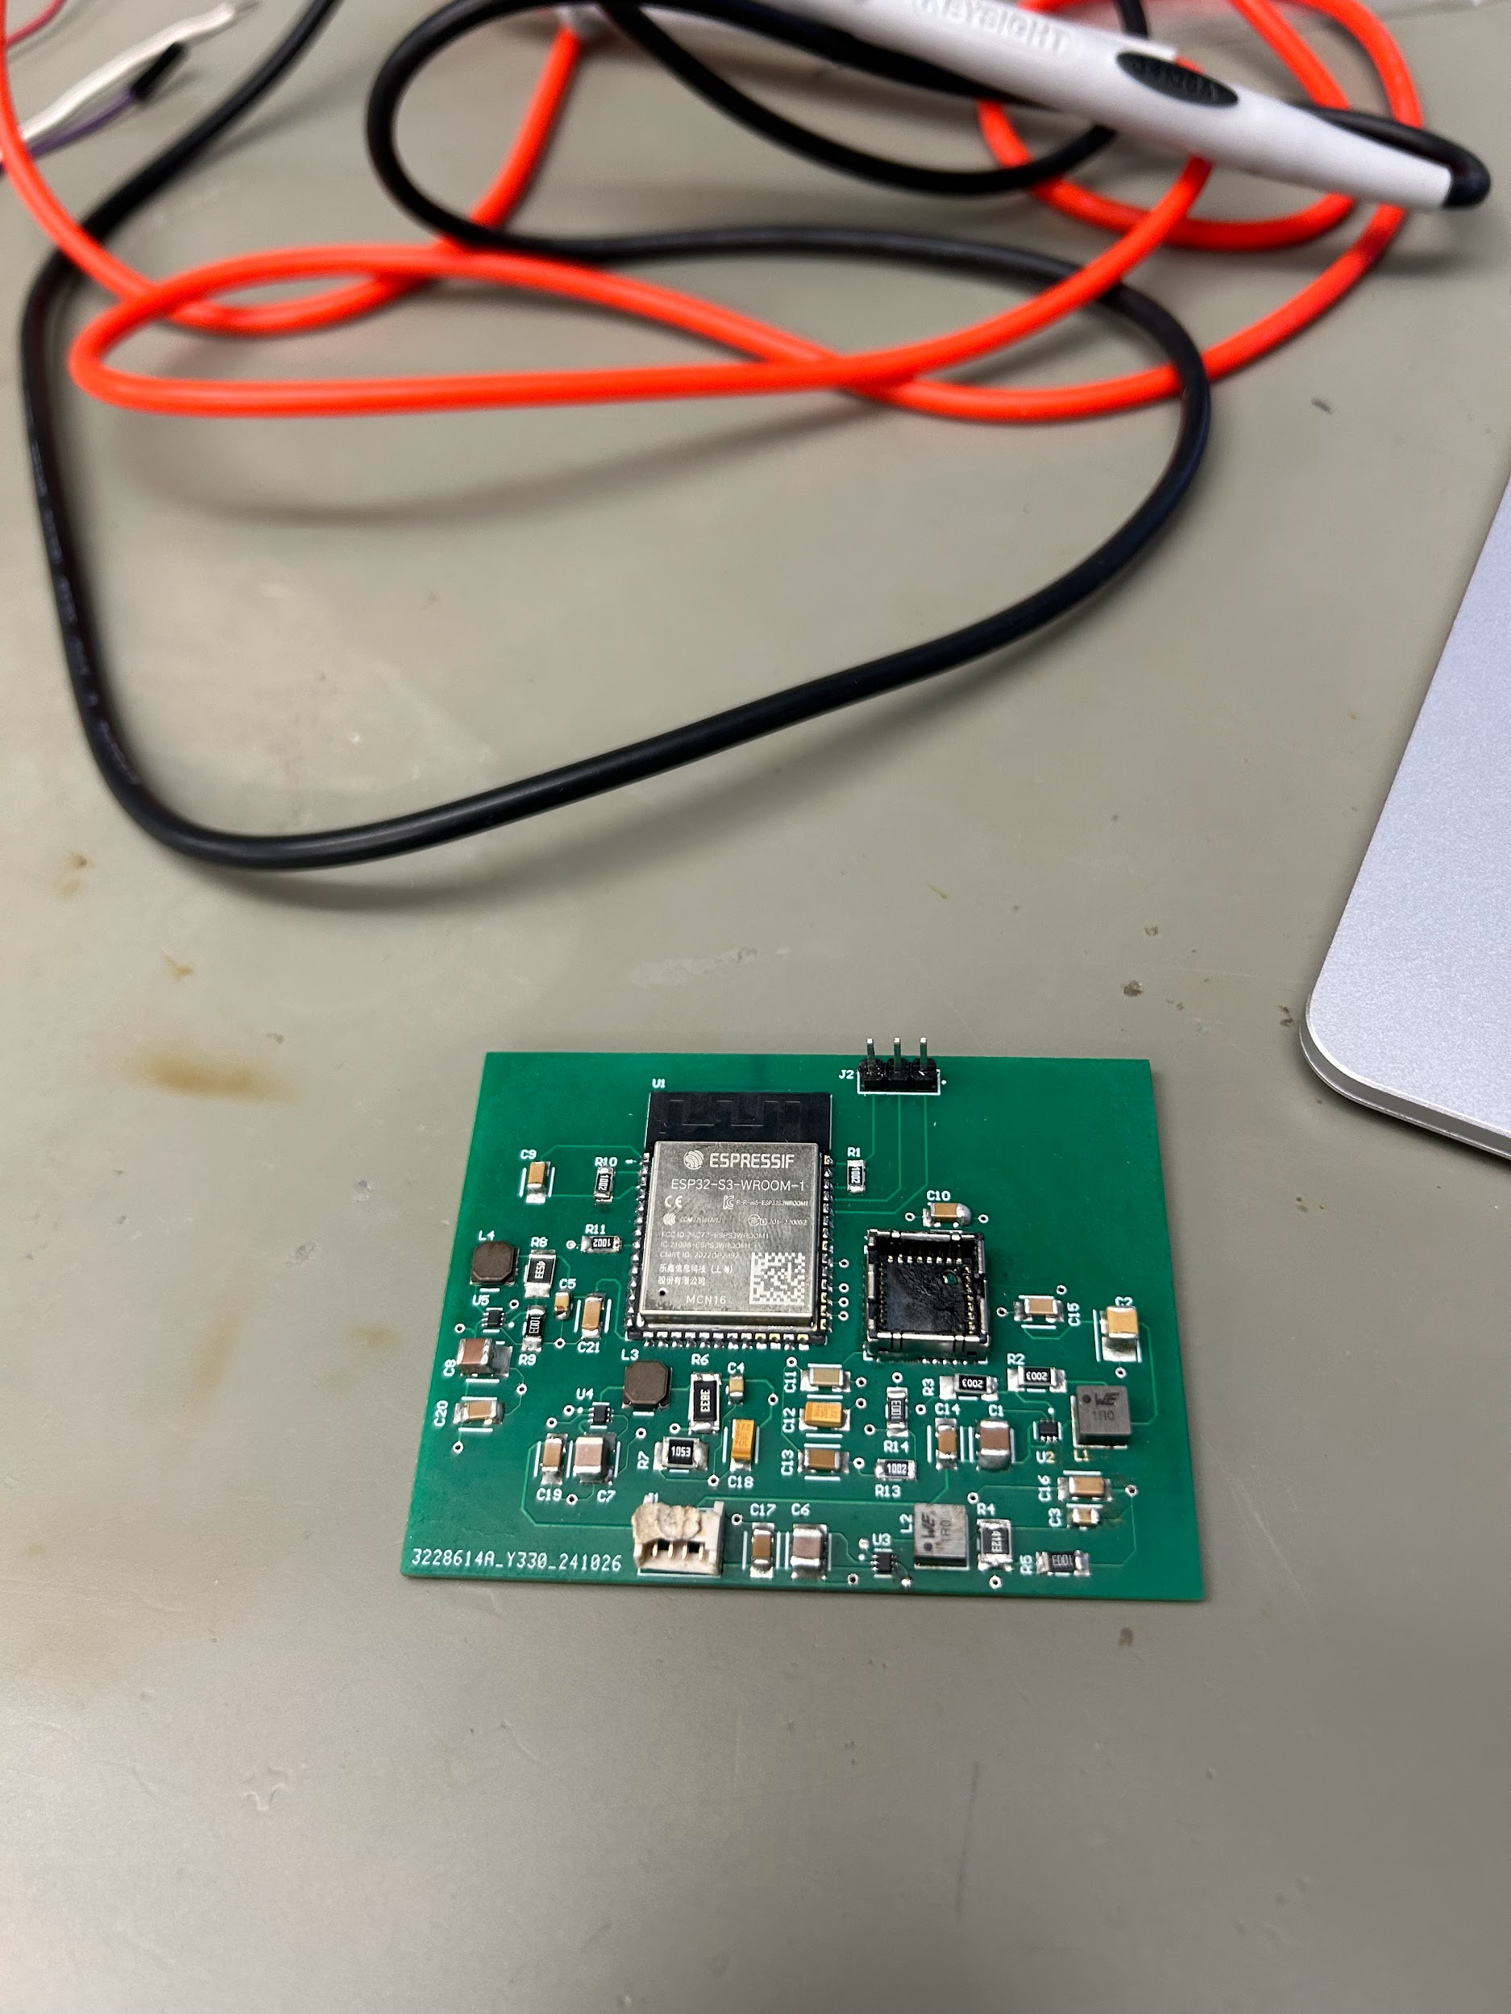
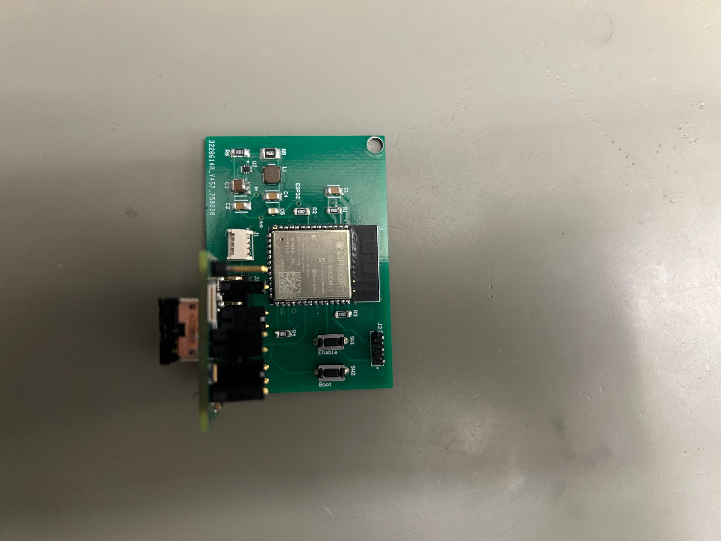
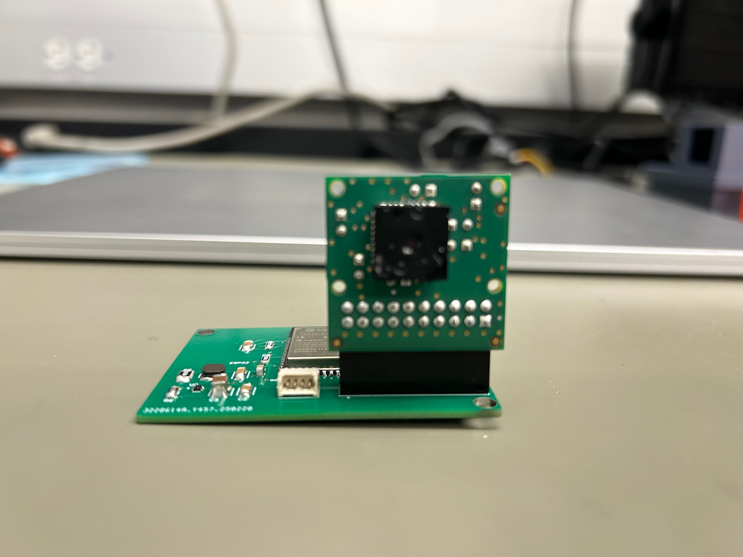
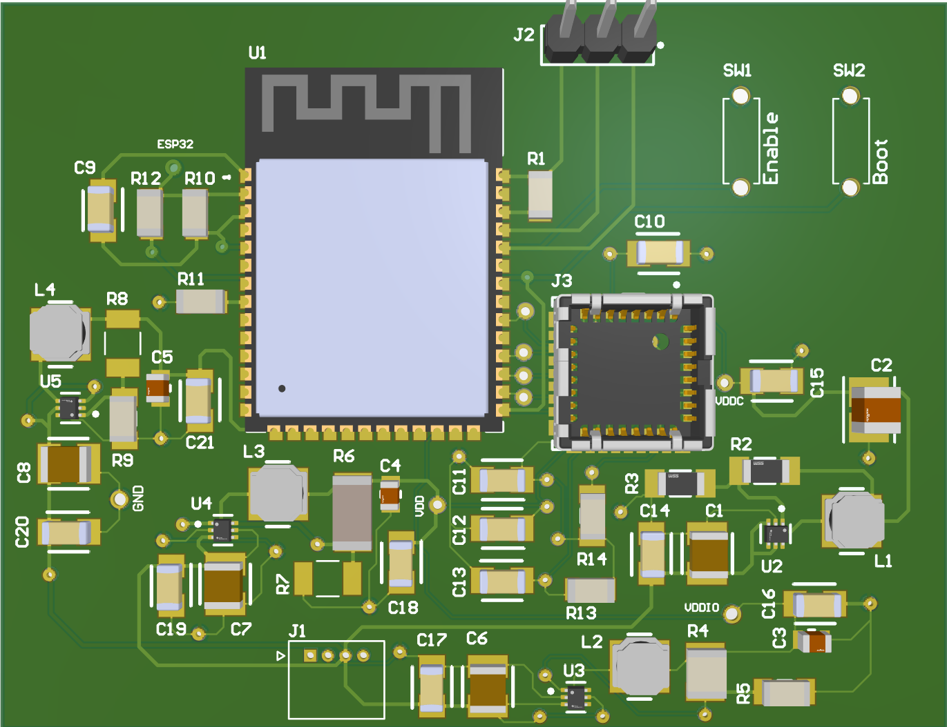
PCB Design Accomplishments
V1: wasn’t able to download code, all four buck converters never worked
V2: able to download and run code, all four buck converters worked, camera socket not viable
V3: able to download and run code, buck converter works, thermal sensor fully functional

Slide 6
PCB Design Accomplishments
Voltage Levels | PCB Version 1 | PCB Version 2 | PCB Version 3
Input | 3.42 V | 3.6 V | 3.68 V
ESP32 Buck Converter | 2.82 V | 3.01 V | 3.179 V
VDDIO Buck Converter | 0.12 V | 3.061 V | N/A
VDD Buck Converter | 2.66 V | 2.804 V | N/A
VDDC Buck Converter | 1.22 V | 1.205 V | N/A
All measurements taken with a multimeter.
Version 3 has a breakout board that replaces the buck converters that power the thermal sensor.

Slide 7
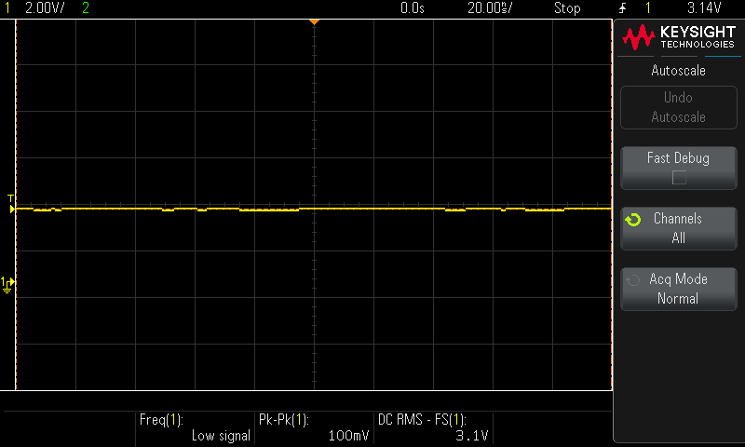
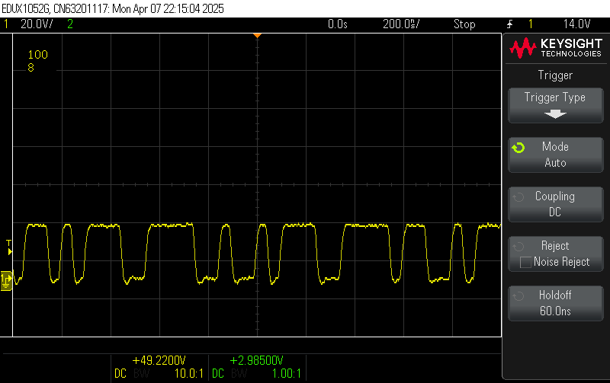
PCB Design Accomplishments
DC voltage powering the ESP32-S3-WROOM-1 captured with an oscilloscope.
RMS value is displayed
Peak-to-peak is displayed
These two measurements show little ripple in the voltage provided.
Data stream between the microcontroller and the thermal sensor captured on an oscilloscope.
The stream is displayed by a digital signal as a waveform.

Slide 8
Microcontroller Design Accomplishments
This subsystem was designed to perform three major functions:
Communicate to with the thermal camera to receive RAW14 image data
Process that image data into an 8-bit grayscale image and run an algorithm to determine if the switch is open or closed
Send the compressed image data and switchstate determination to the desired website through Wi-Fi

Slide 9
Microcontroller Design Accomplishments
Challenges and Solutions:
Memory space is very limited on the ESP-32 for our purposes
This was handled by meticulously allocating dynamic memory
The RAW14 data doesn’t have the lowest pixel value starting at 0, making a compression of the image difficult
This was handled by normalizing the pixel data using the formula:
T_{n} = (t_{i} - t_{min}) * [255 / (t_{max} - t_{min})]
There were multiple types of information we wanted the microcontroller to send to the website at the same time
This was handled by send an HTTP post request with multiple headers representing multiple types of information

Slide 10
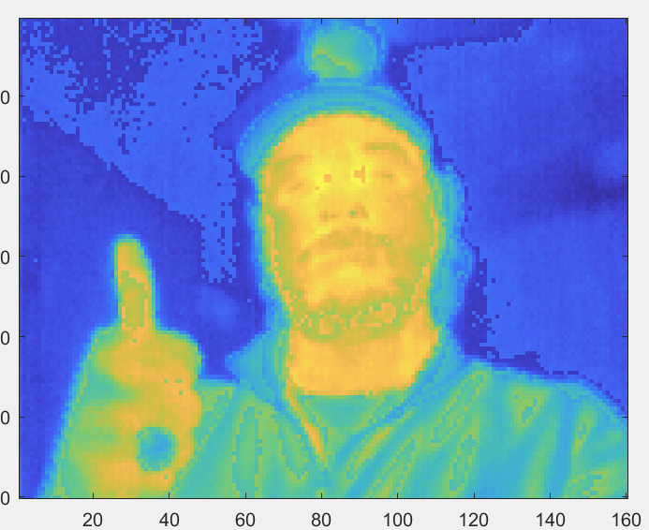
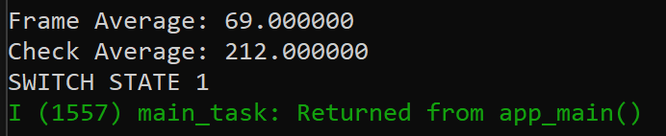
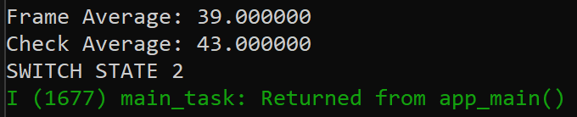
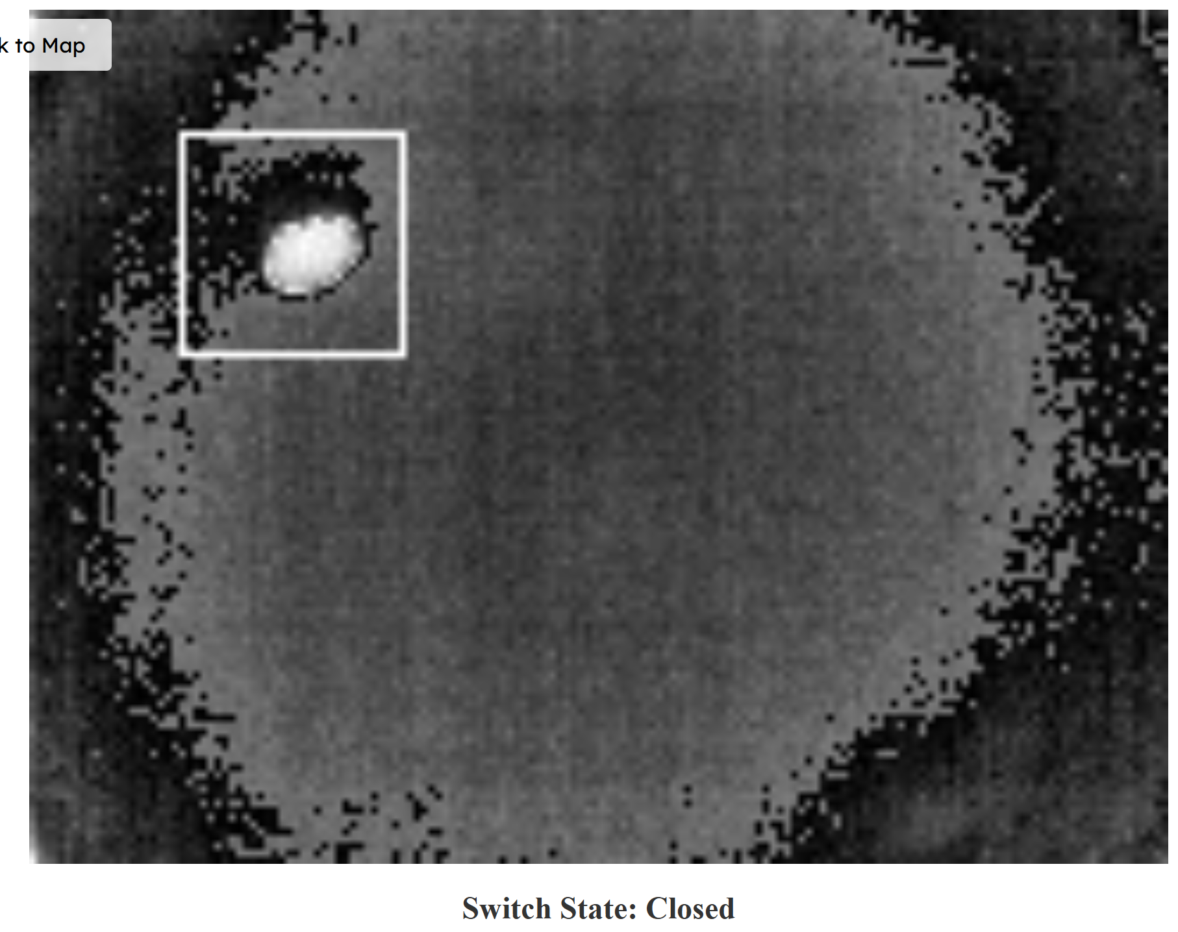
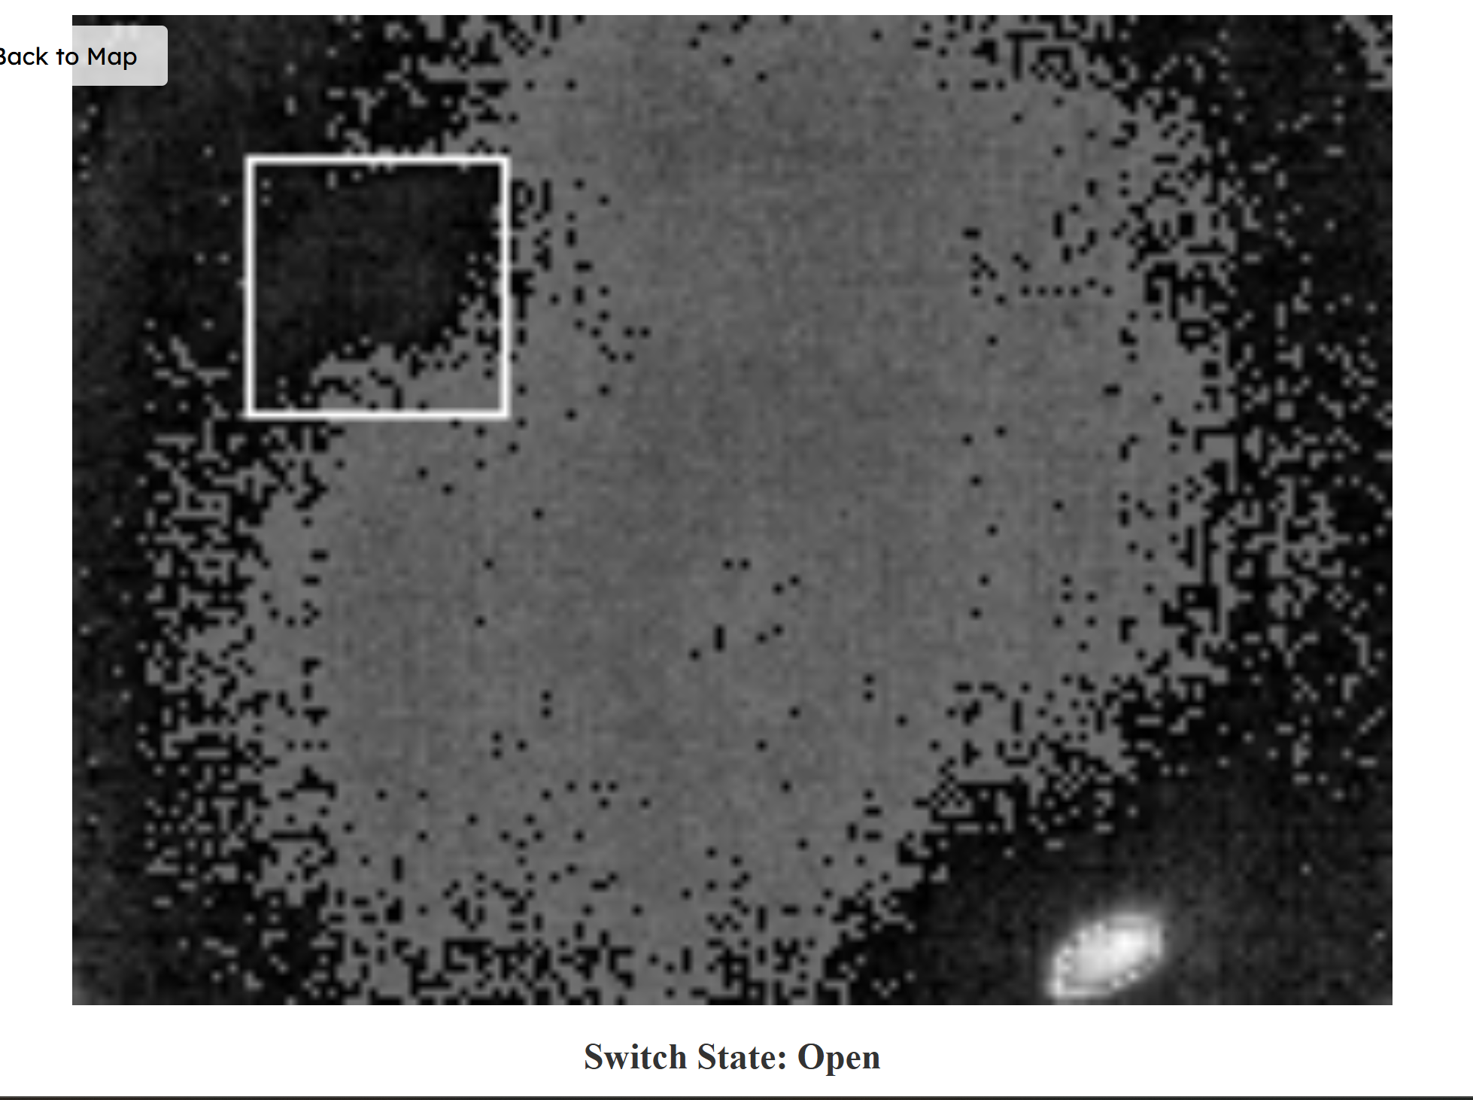
Microcontroller Design Accomplishments
Switch Determination (Closed) from Console
Photo data taken from the microcontroller
Switch Determination (Open) from Console

Slide 11
Website Design Accomplishments
This subsystem was designed to:
Continuously receive Post Requests from the microcontroller with both the Raw Image data + Switch State
Convert the Raw image data to a viewable photo
Constantly update the image + switch state as new data is sent from the microcontroller
Challenges:
Server not being able to process post requests at a fast enough rate
Issues with image conversion

Slide 12
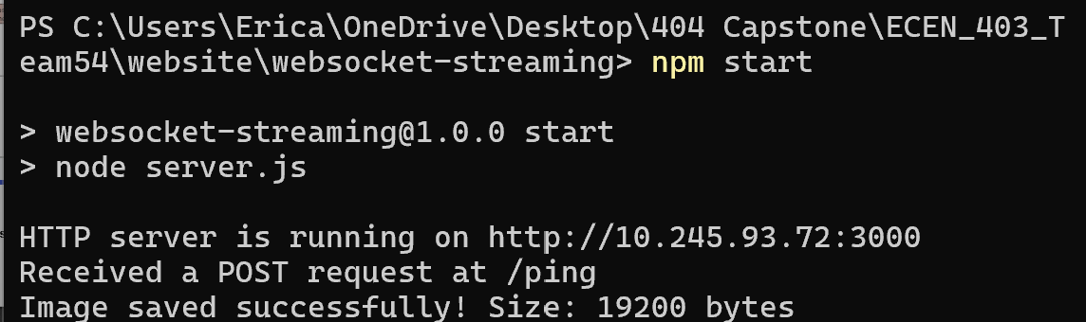
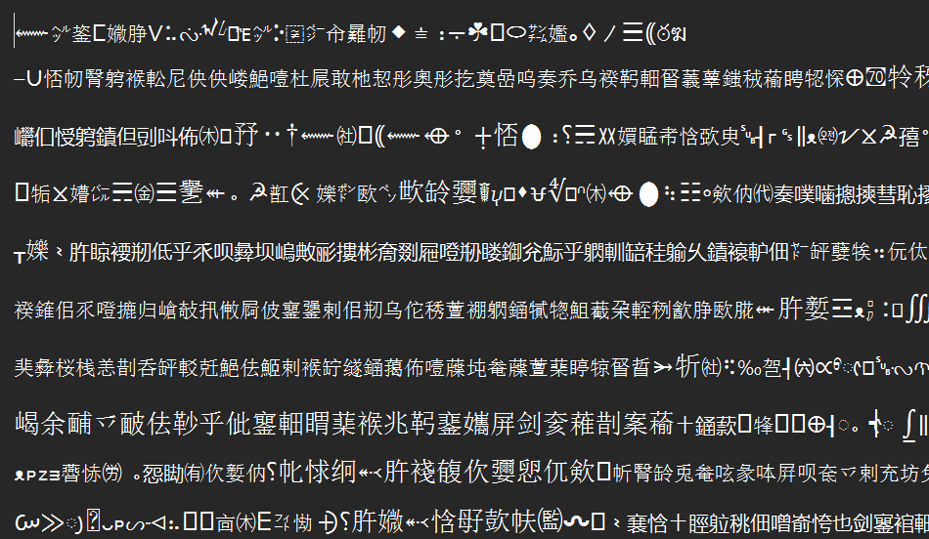
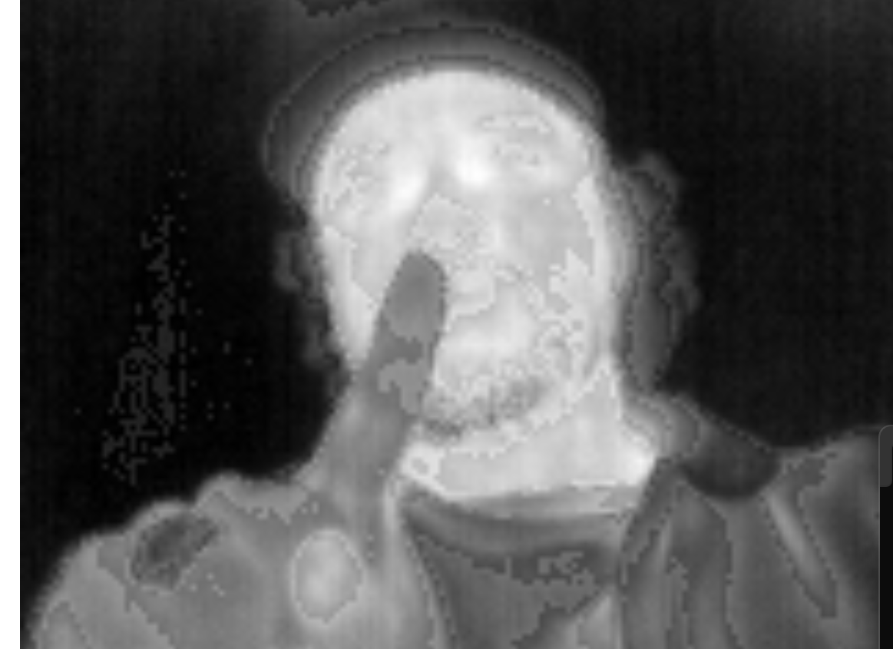
Website Design Accomplishments
Server first receives both 8-bit grayscale data and Switch State from the microcontroller as a POST Request
Converts the raw grayscale data to PNG using Sharp in-memory
Server then writes the PNG to the disk to be displayed on the website + displays Switch State
Image Received from Microcontroller
This process constantly repeats as the Microcontroller sends images
8-bit grayscale Data
Output PNG

Slide 13
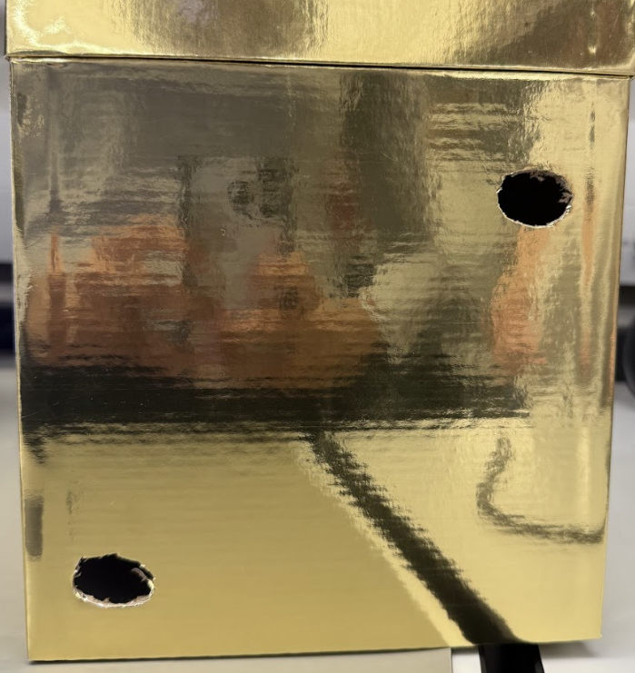
Website Design Accomplishments
Makeshift Switchgear for Demo
Heat Source to mimic switch
Switch State

Slide 14
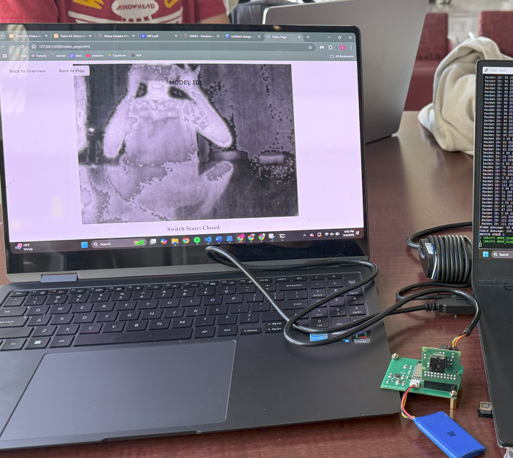
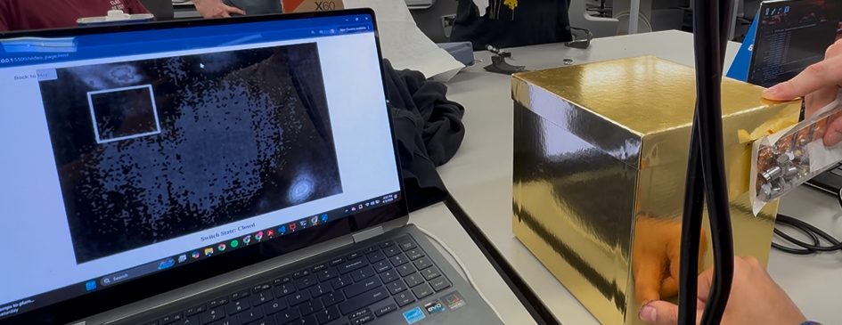
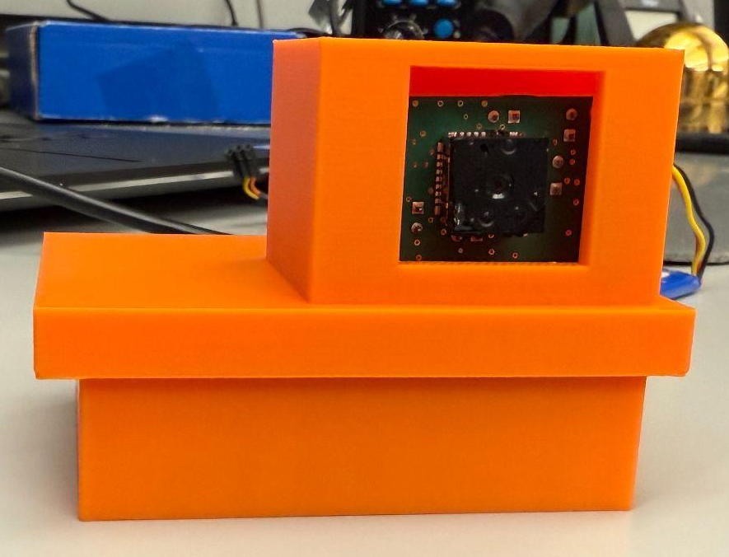
Integrated System Results
Passed Dielectrics Test at POWELL

Slide 15
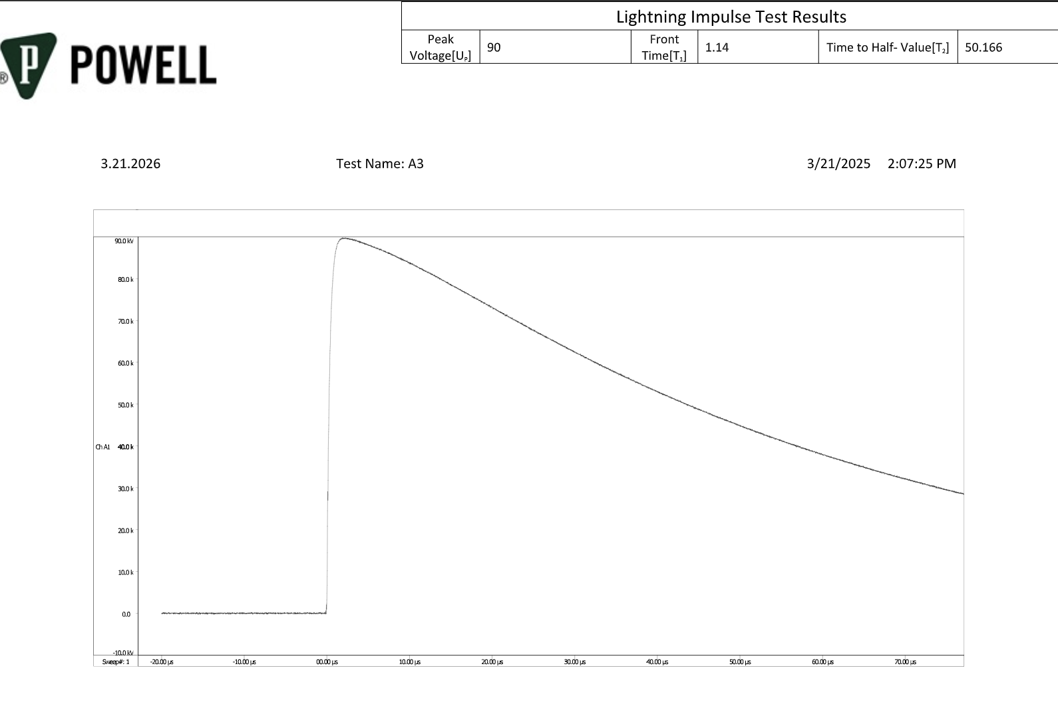
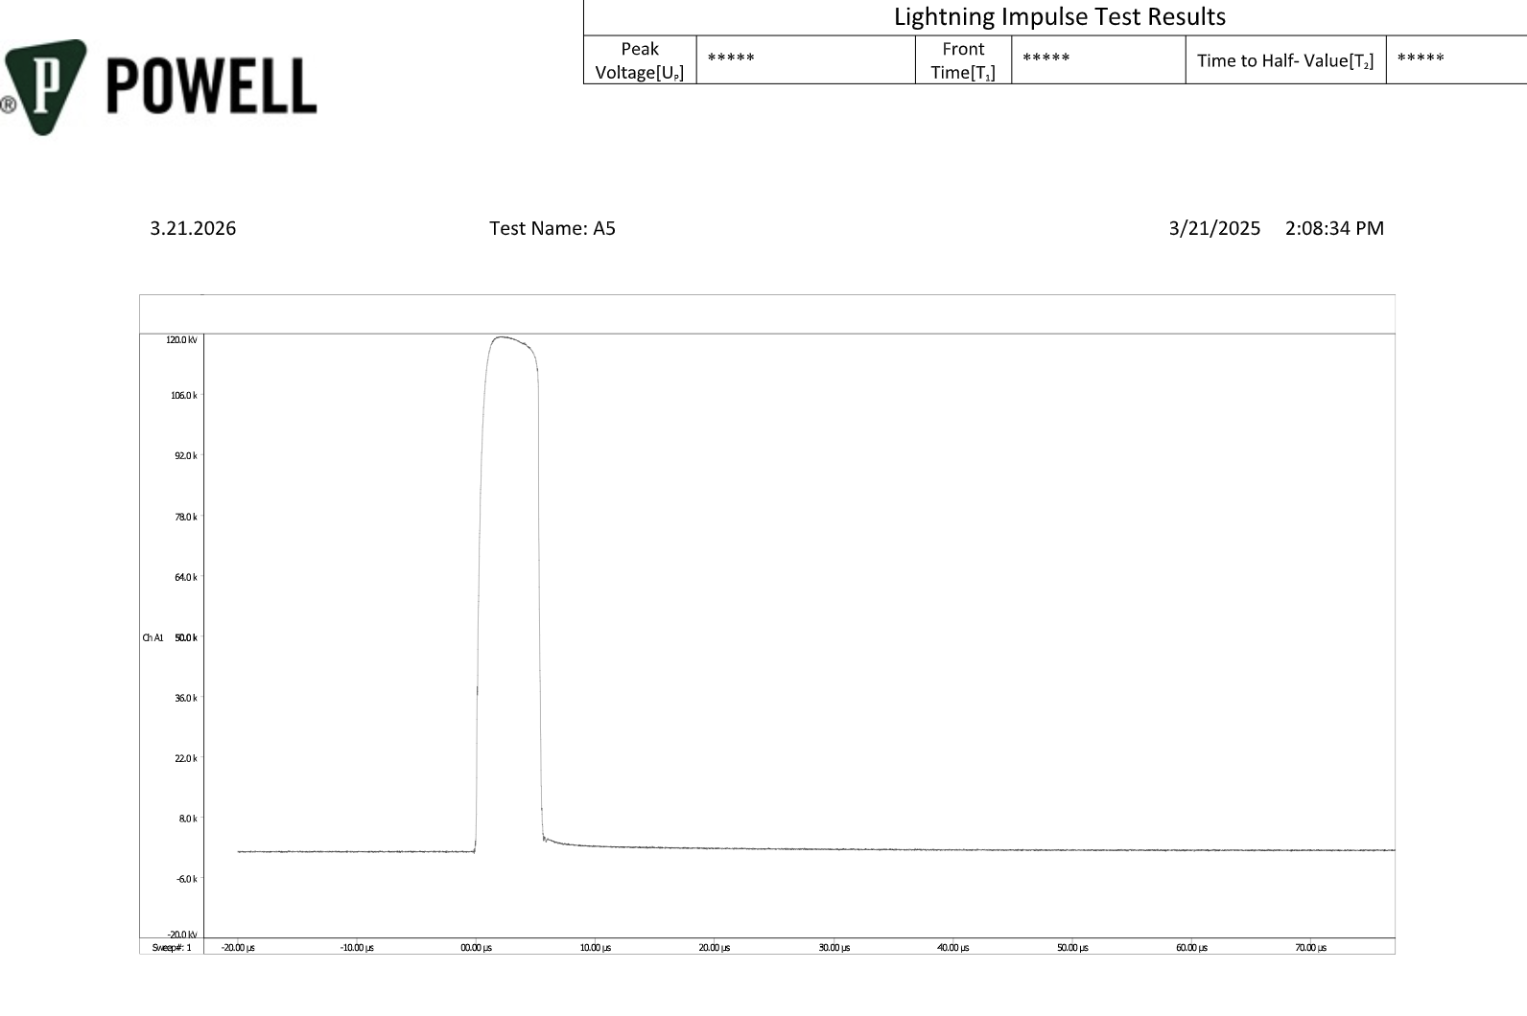
Integrated System Results
POWELL’s internal guidance recommends an air clearance of 6 inches in order to achieve a 95 kV BIL withstand rating.
Successful BIL Test at 90 kV
Failed BIL Test at 120 kV
POWELL approved our design and deemed it viable to reach the 95 kV level at 6 inches
Notes:
This represents a point to plane dielectric stress of an uninsulated conductor as it may be seen in switchgear.

Slide 16
Conclusions
Hardware Changes
The first microcontroller couldn’t download code, so push-buttons were added to the original design.
The camera socket wasn’t viable, so the entire design was updated to replace the socket and the three buck converters providing power to the socket with a connector and a breakout board.
Software Changes
Switched from using a websocket server to sending individual HTTP Post Request.
Integration, testing, and validation are complete.
All subsystem validation is complete.
Integrated system validation complete and demonstrated to TA.

